Slide 1


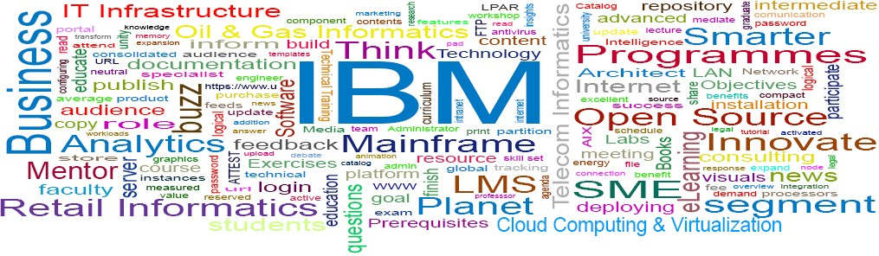
IBM ICE (Innovation Centre for Education)
Welcome to:
Case study on virtualization and cloud workloads
9.1

Slide 2
Unit Objectives
IBM ICE (Innovation Centre for Education)
After completing this unit, you should be able to:
Identify the practical considerations for virtualization
Understand the need to prepare for virtualization
Describe the various steps in preparation
Explain the different transition tools for virtualization
Define cloud workloads

Slide 3

Case study overview
IBM ICE (Innovation Centre for Education)

Slide 4
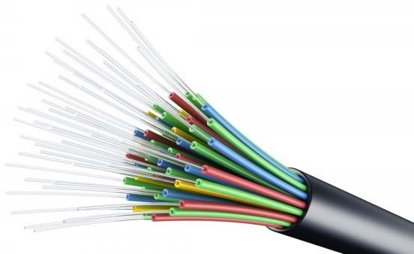
Customer IT landscape
IBM ICE (Innovation Centre for Education)

Slide 5
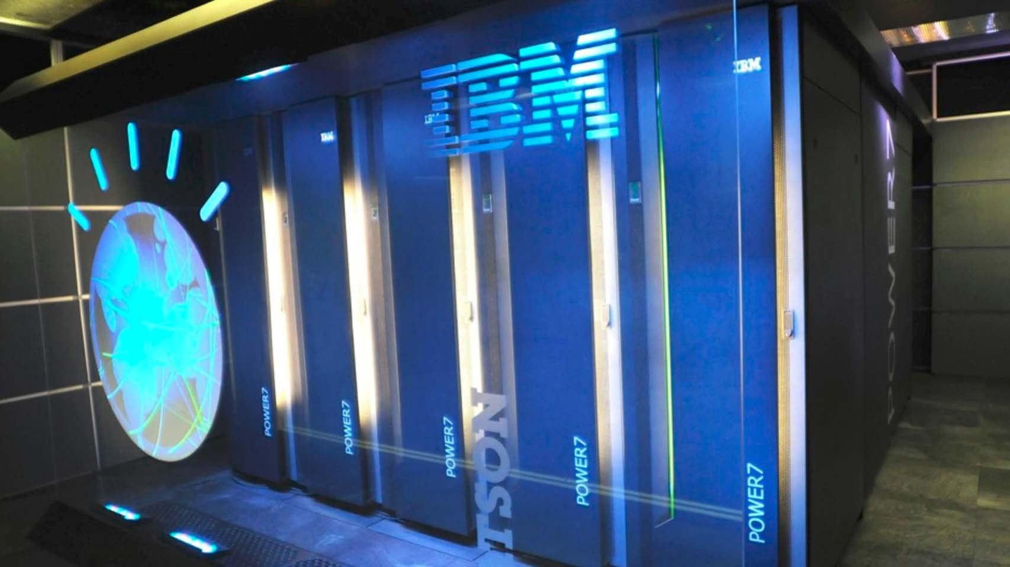
Functions of the data center
IBM ICE (Innovation Centre for Education)

Slide 6
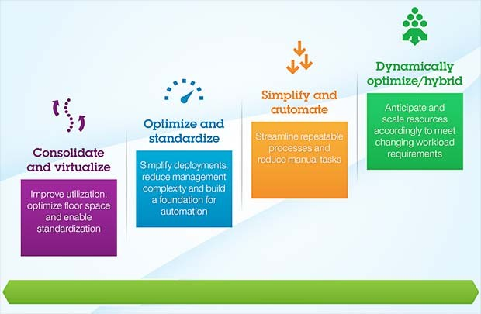
Triggers for virtualization (1 of 2)
IBM ICE (Innovation Centre for Education)

Slide 7
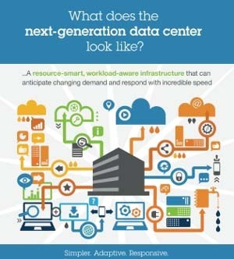
Triggers for virtualization (2 of 2)
IBM ICE (Innovation Centre for Education)

Slide 8

Preparation for virtualization
IBM ICE (Innovation Centre for Education)

Slide 9
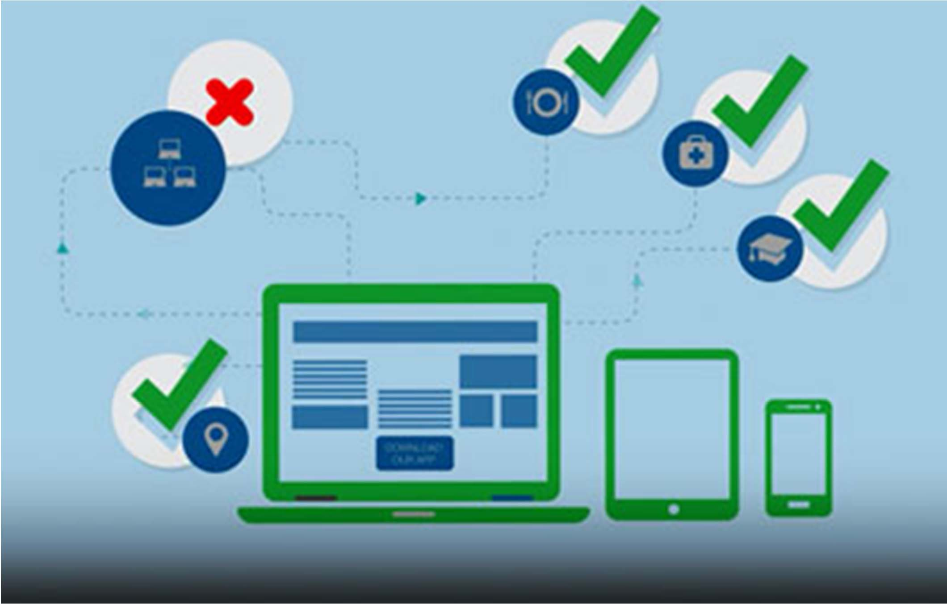
Server selection (1 of 2)
IBM ICE (Innovation Centre for Education)

Slide 10

Server selection (2 of 2)
IBM ICE (Innovation Centre for Education)

Slide 11
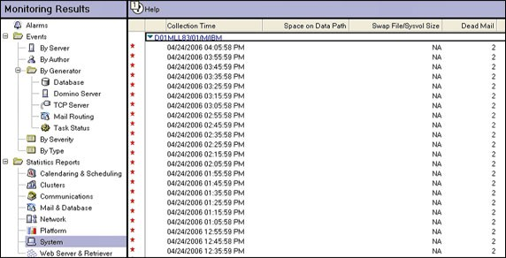
Server sizing (1 of 2)
IBM ICE (Innovation Centre for Education)

Slide 12
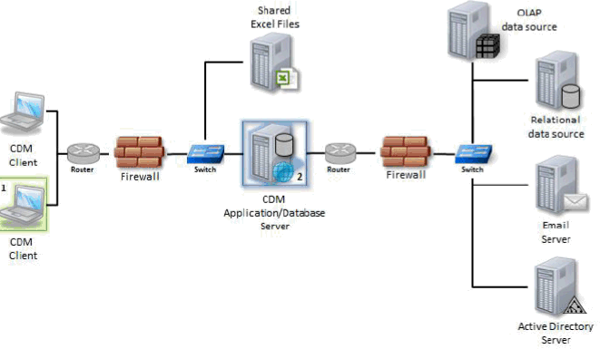
Server sizing (2 of 2)
IBM ICE (Innovation Centre for Education)

Slide 13
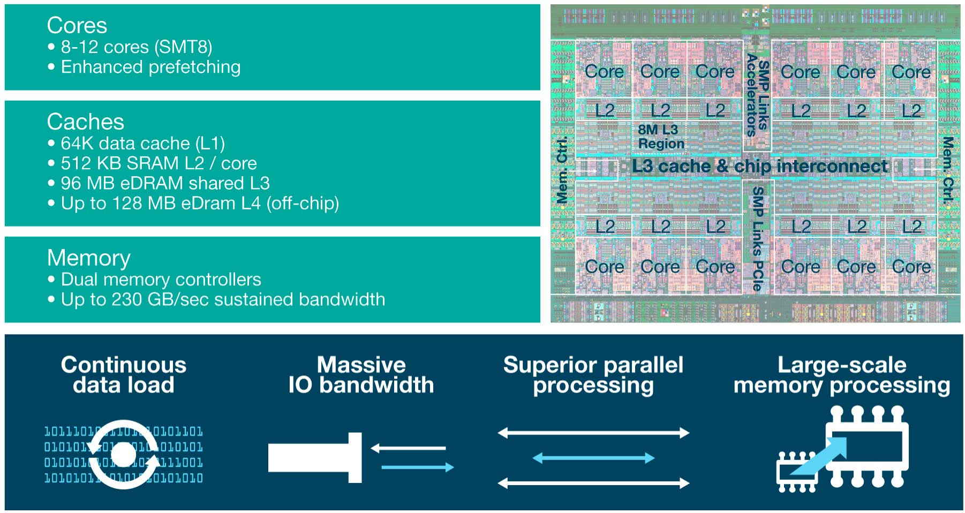
Server criticality
IBM ICE (Innovation Centre for Education)

Slide 14
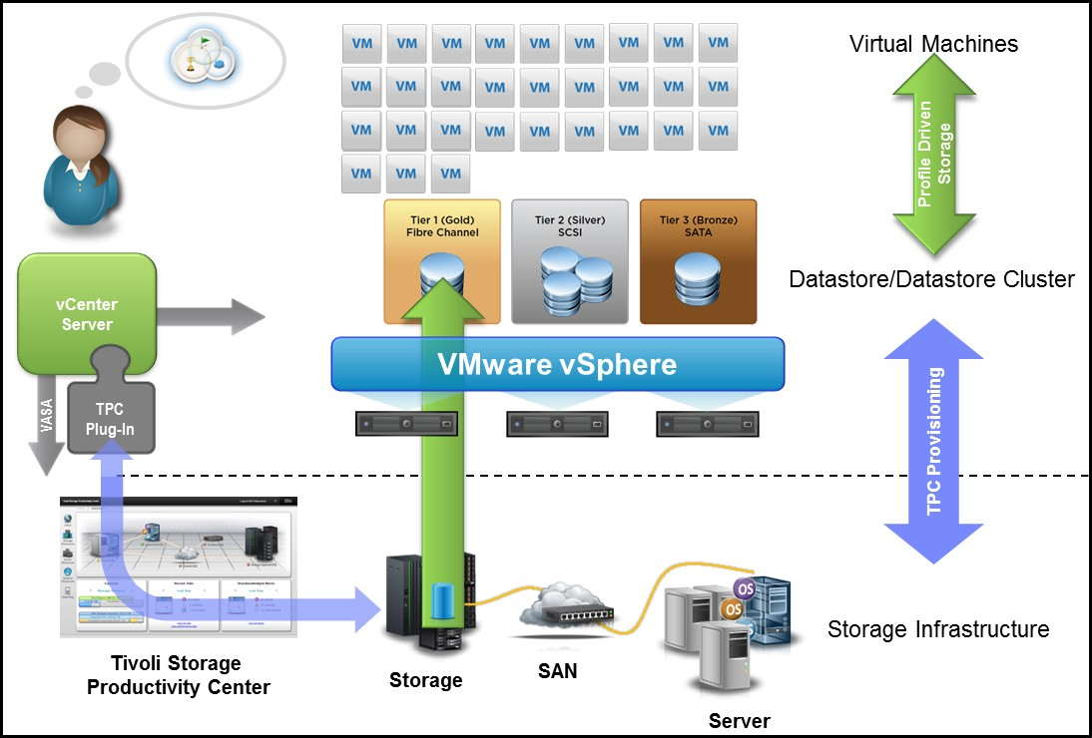
Provisioning (1 of 2)
IBM ICE (Innovation Centre for Education)

Slide 15

Provisioning (2 of 2)
IBM ICE (Innovation Centre for Education)

Slide 16
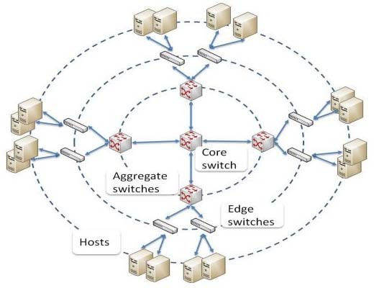
Proximity and Locality
IBM ICE (Innovation Centre for Education)

Slide 17
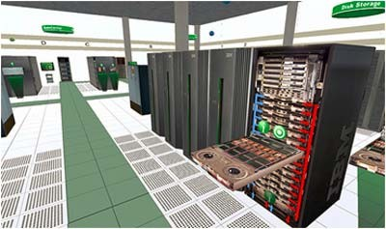
Transition tools for virtualization
IBM ICE (Innovation Centre for Education)

Slide 18

Cost Savings
IBM ICE (Innovation Centre for Education)
Typical cost saving experienced by FiberCoils after moving to virtualization is in the range of 40%. This includes saving on the datacenter space, physical servers, operational costs and easy manageability of the IT infrastructure.

Slide 19
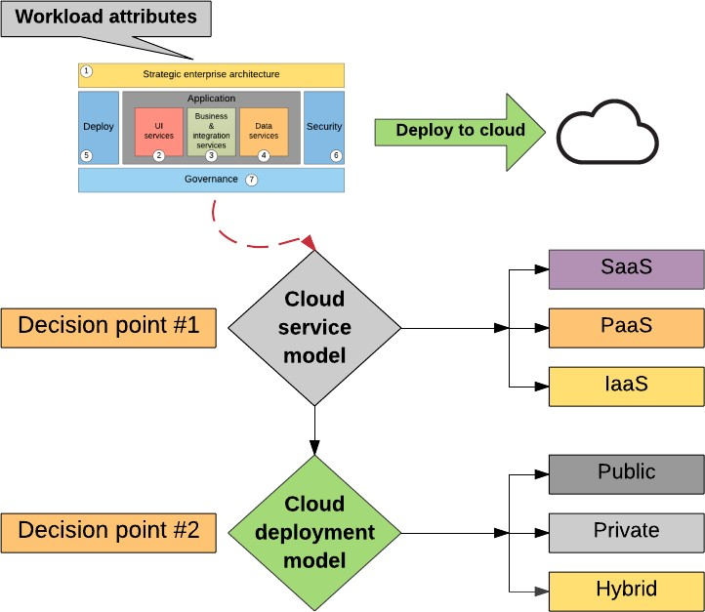
Cloud Workloads Overview
IBM ICE (Innovation Centre for Education)

Slide 20
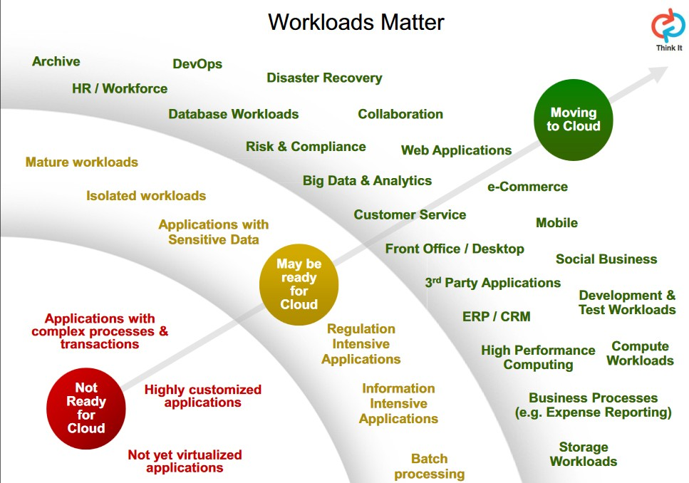
What is workload?
IBM ICE (Innovation Centre for Education)

Slide 21
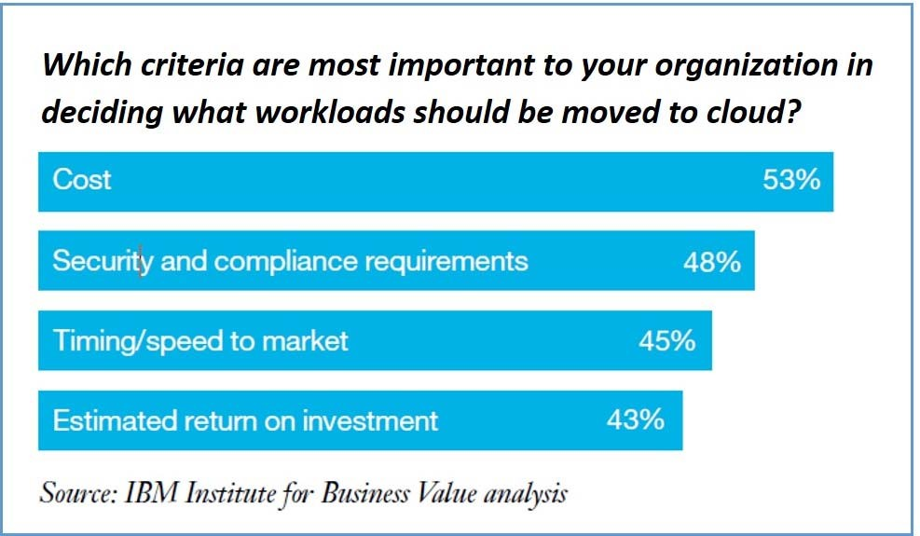
Workload characterization
IBM ICE (Innovation Centre for Education)

Slide 22
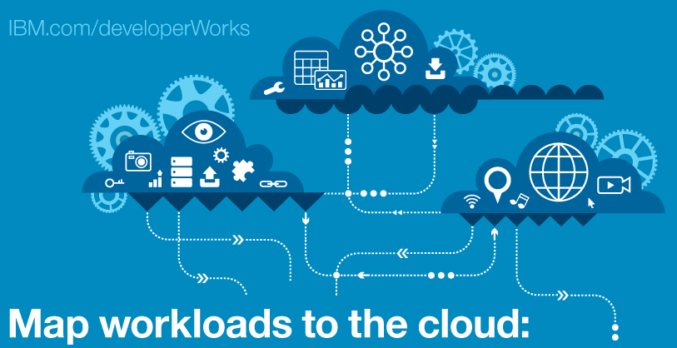
Factors that influence cloud workload
IBM ICE (Innovation Centre for Education)

Slide 23
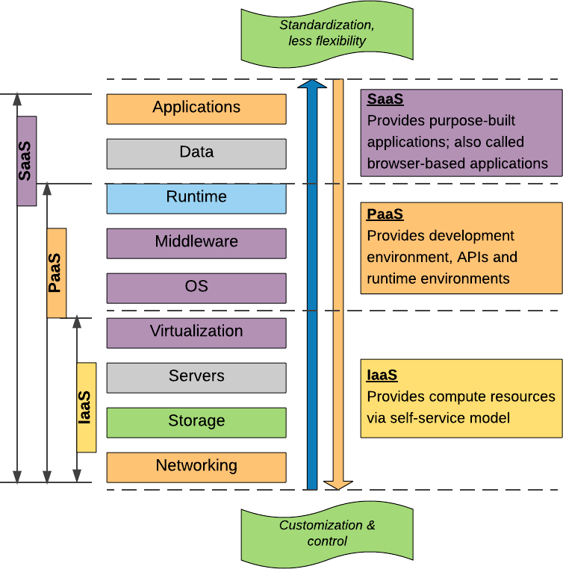
Workloads most suitable for cloud
IBM ICE (Innovation Centre for Education)

Slide 24
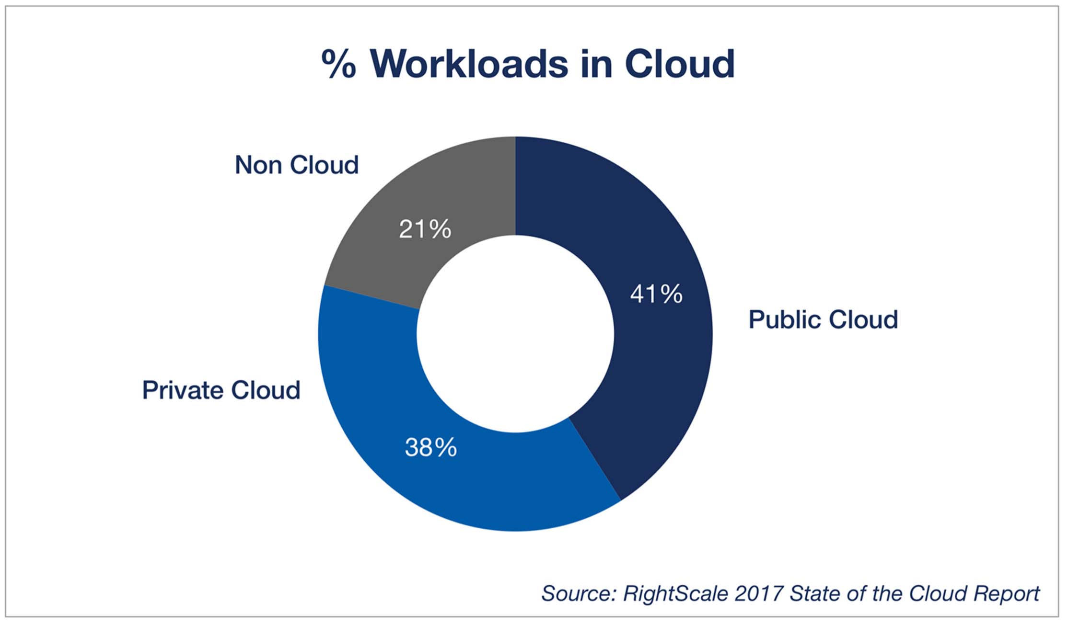
Private cloud solution
IBM ICE (Innovation Centre for Education)

Slide 25
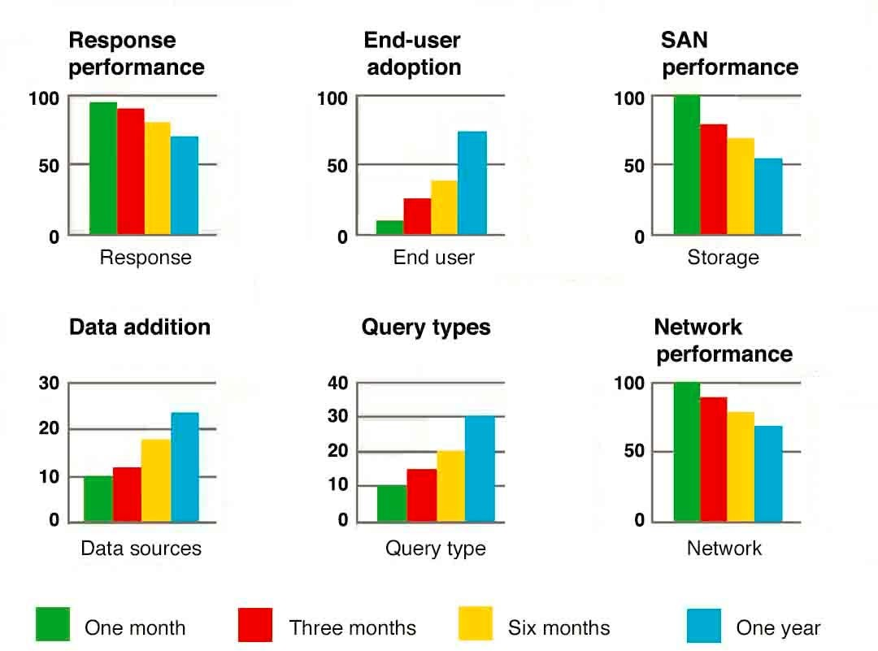
Types of workload
IBM ICE (Innovation Centre for Education)

Slide 26
Temporary non-production workloads
IBM ICE (Innovation Centre for Education)
Temporary non-production workloads are preferably placed on a public cloud.
Examples of temporary workload are:
Workload I
Workload II

Slide 27
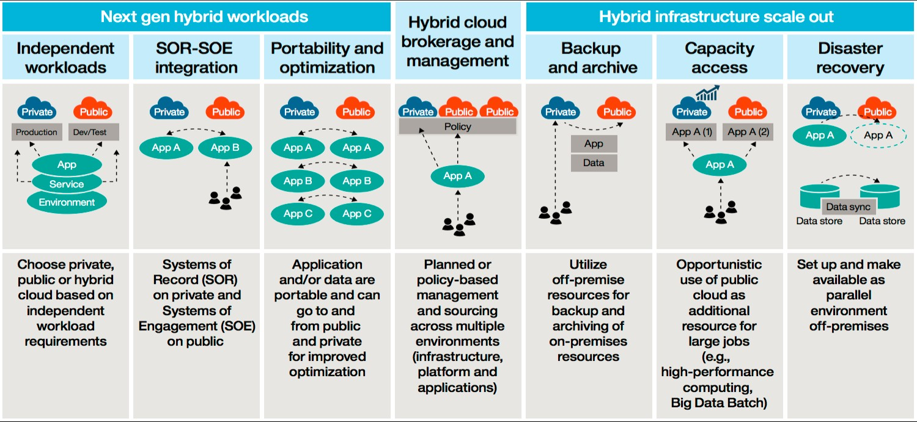
Mission critical production workloads
IBM ICE (Innovation Centre for Education)

Slide 28
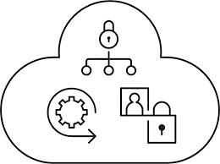
Advantages
IBM ICE (Innovation Centre for Education)

Slide 29
Mission critical workloads
IBM ICE (Innovation Centre for Education)
Examples of mission critical workloads:
Workload I
Workload II

Slide 30
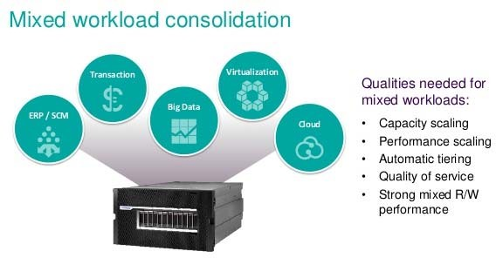
Mixed workloads
IBM ICE (Innovation Centre for Education)

Slide 31
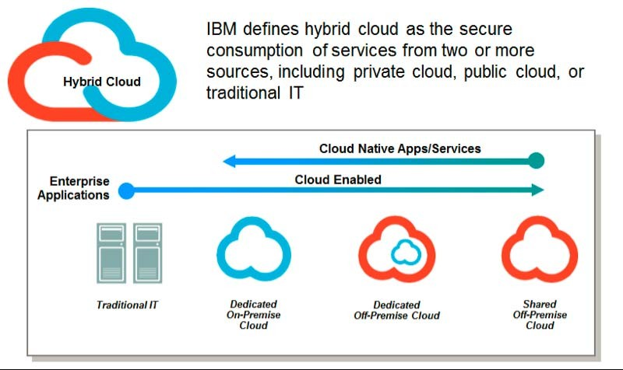
Production only workload most suitable
for a hybrid cloud
IBM ICE (Innovation Centre for Education)

Slide 32
Industry specific cloud workloads
IBM ICE (Innovation Centre for Education)
Examples:
Ecommerce
Healthcare
Education Sector

Slide 33
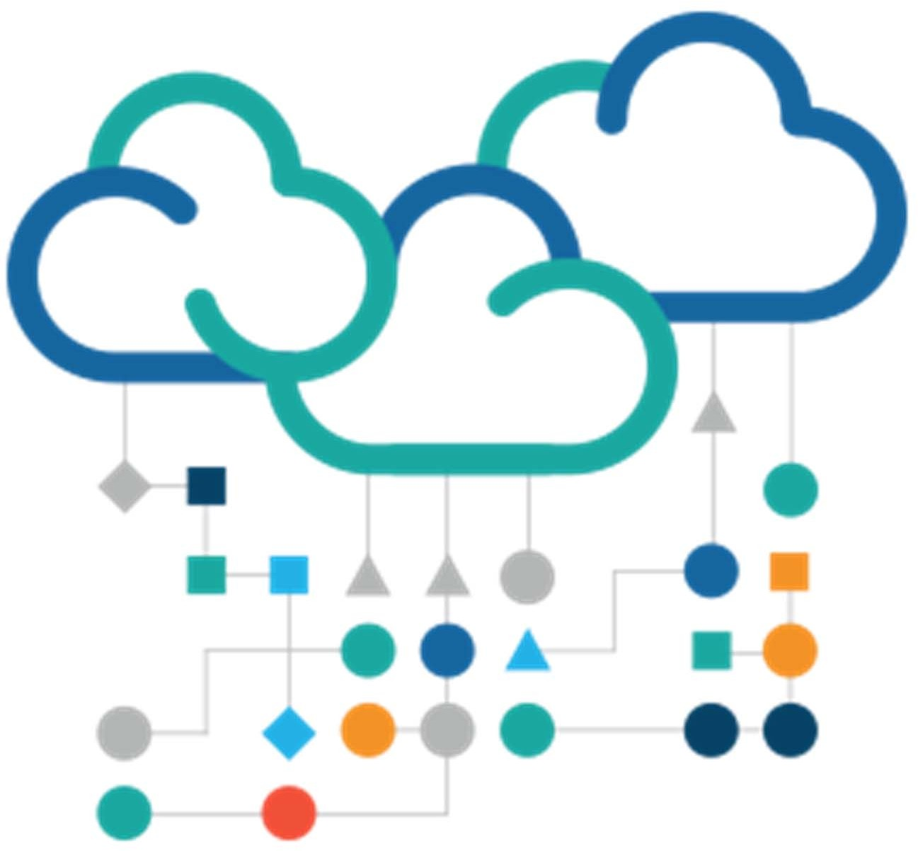
Workloads not suitable for public cloud
IBM ICE (Innovation Centre for Education)

Slide 34
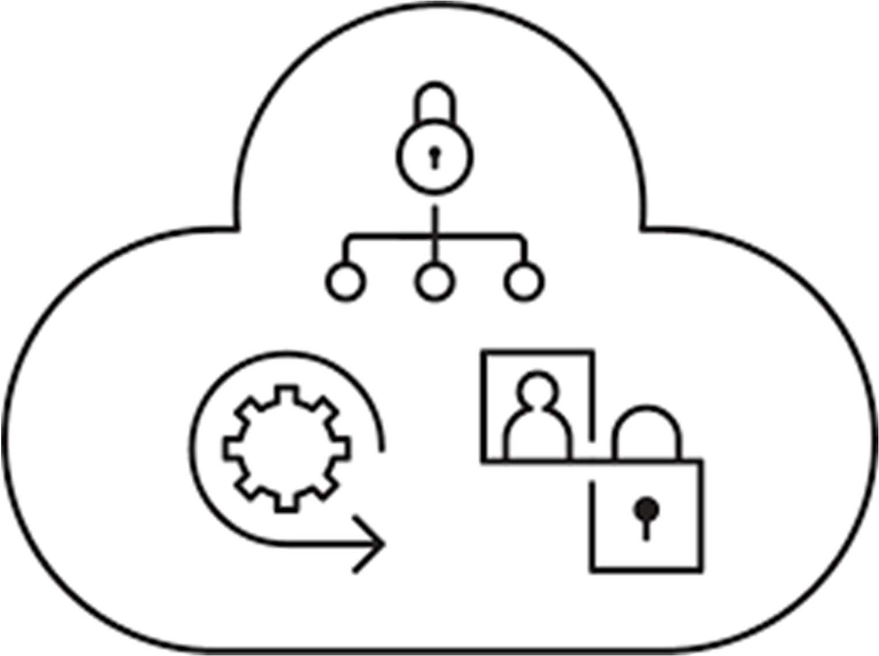
Workloads not suitable for private cloud
IBM ICE (Innovation Centre for Education)

Slide 35
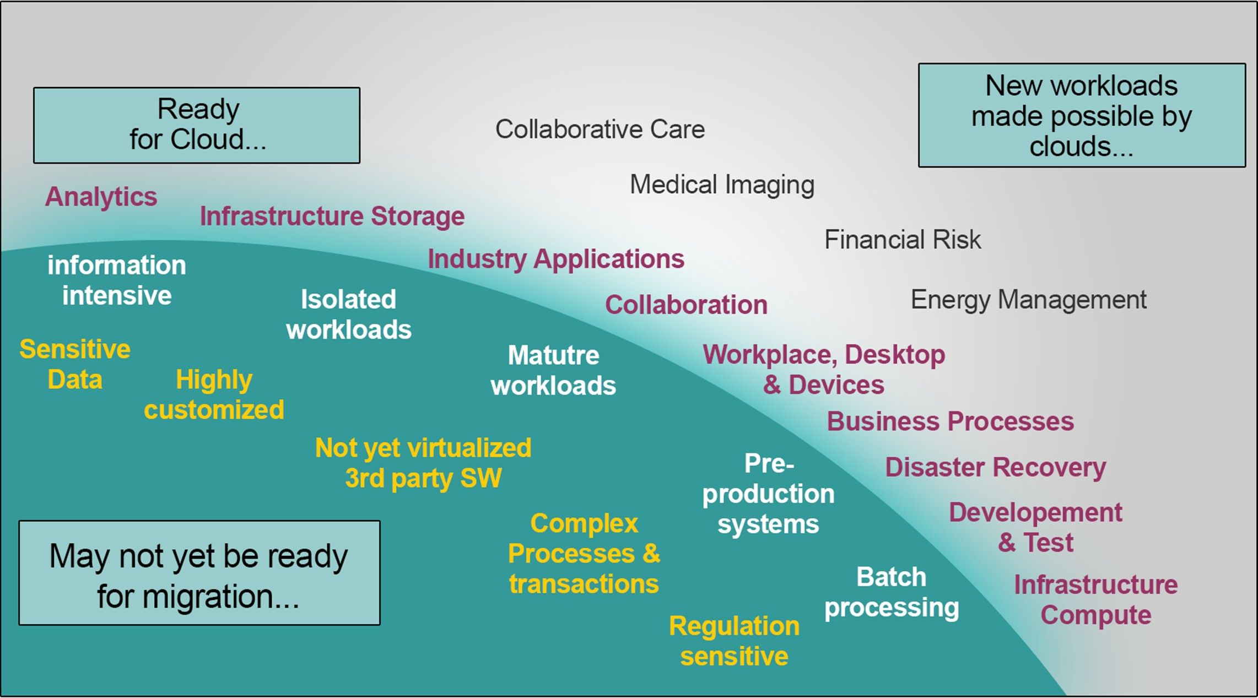
Workloads made possible by cloud
IBM ICE (Innovation Centre for Education)

Slide 36
Checkpoint (1 of 2)
IBM ICE (Innovation Centre for Education)
The customer must run ……………………… tools to determine the effective utilization of each server.
All qualified servers for virtualization will be classified under two major categories –
VMs and Computer Systems
VMs and VDIs
VMs and Hypervisors
Hypervisors and Computer Systems
A set of servers that serve critical functions in the organization and Servers that constantly run at a higher utilization about 95% of the time can be retained as physical servers
True
False
……………………………………….. enables dependent servers to be placed together on the same physical server and colocated locally to enable better communication and reduction in communication and IO latency.
A virtualization vendor provides its own custom tools for consolidating a physical infrastructure. Among many tools one major category of tools is ………………. (which provide mechanisms for creating, managing, storing and deleting virtual machines in the datacenter. In addition to the basic functionality, the tools provide mechanisms for monitoring and ongoing optimization of the current IT infrastructure.)

Slide 37
Checkpoint Solution (1 of 2)
IBM ICE (Innovation Centre for Education)
The customer must run performance tools to determine the effective utilization of each server.
All qualified servers for virtualization will be classified under two major categories –
VMs and Computer Systems
VMs and VDIs
VMs and Hypervisors
Hypervisors and Compuer Systems
A set of servers that serve critical functions in the organization and Servers that constantly run at a higher utilization about 95% of the time can be retained as physical servers
True
False
Virtualization enables dependent servers to be placed together on the same physical server and co- located locally to enable better communication and reduction in communication and IO latency.
A virtualization vendor provides its own custom tools for consolidating a physical infrastructure. Among many tools one major category of tools is Manageability Tools (which provide mechanisms for creating, managing, storing and deleting virtual machines in the datacenter. In addition to the basic functionality, the tools provide mechanisms for monitoring and ongoing optimization of the current IT infrastructure.)

Slide 38
Checkpoint (2 of 2)
IBM ICE (Innovation Centre for Education)
The workload consists of some amount of application program running in the computer and usually some number of users connected to and interacting with the computer's applications. The notion of a workload is central to Cloud Computing. Mainly, a workload is a discrete capability or amount of work you'd like to run on a Cloud instance. For example, serving up a Web site or running a Hadoop node are classic examples of workloads.
True
False
The best way to profile a workload for a cloud type is to classify the application in tiers: Tier-1 to Tier-4. An SLA can be associated with each Tier. If the SLA provided by a cloud service vendor does not meet the SLA required for a Tier, the application has to be hosted on Cloud implementation that the SLA requirement.
deceeds or meets
meets or exceeds
meets only
none
8. Regulated Industry workloads adhering to PCI, HIPPA compliance regulations are not suitable for Clouds. These are best suited for Clouds.
a. private, public
b. hybrid, public
c. public, private
d. note

Slide 39
Checkpoint Solution (2 of 2)
IBM ICE (Innovation Centre for Education)
The workload consists of some amount of application program running in the computer and usually some number of users connected to and interacting with the computer's applications. The notion of a workload is central to Cloud Computing. Mainly, a workload is a discrete capability or amount of work you'd like to run on a Cloud instance. For example, serving up a Web site or running a Hadoop node are classic examples of workloads.
True
False
The best way to profile a workload for a cloud type is to classify the application in tiers: Tier-1 to Tier-4. An SLA can be associated with each Tier. If the SLA provided by a cloud service vendor does not meet the SLA required for a Tier, the application has to be hosted on Cloud implementation that the SLA requirement.
deceeds or meets
meets or exceeds
meets only
none
8. Regulated Industry workloads adhering to PCI, HIPPA compliance regulations are not suitable for Clouds. These are best suited for Clouds.
a. private, public
b. hybrid, public
c. public, private
d. note

Slide 40
Unit summary
IBM ICE (Innovation Centre for Education)
Having completed this unit, you should be able to:
Identify the practical considerations for virtualization
Understand the need to prepare for virtualization
Describe the various steps in preparation
Explain the different transition tools for virtualization
Define cloud workloads

